Slide 1
進捗報告
細山田 真也
Jan. 20
Notes:
----- 会議メモ (18/09/10 14:18) -----
I would like to talk about “efpp: A preprocessor for Modern Fortran” . This is a colaborated work with professer Kageyama.

Slide 2
進捗
境界条件の変更
新たな初期条件の導入
構造の発見
Notes:
This is the outline my talk today.
First, I will present background of my purpose today.
Then, I will introduce some features of our direct named efortan.
And , I will explane those features with sample source codes.

Slide 3
境界条件の変更
Stress-free 境界
rigid 境界
0
v
0
v
0
Notes:
Rigid境界の方が自然界で一般的
問題になるのは流れのエネルギーが消えてしまうこと

Slide 4
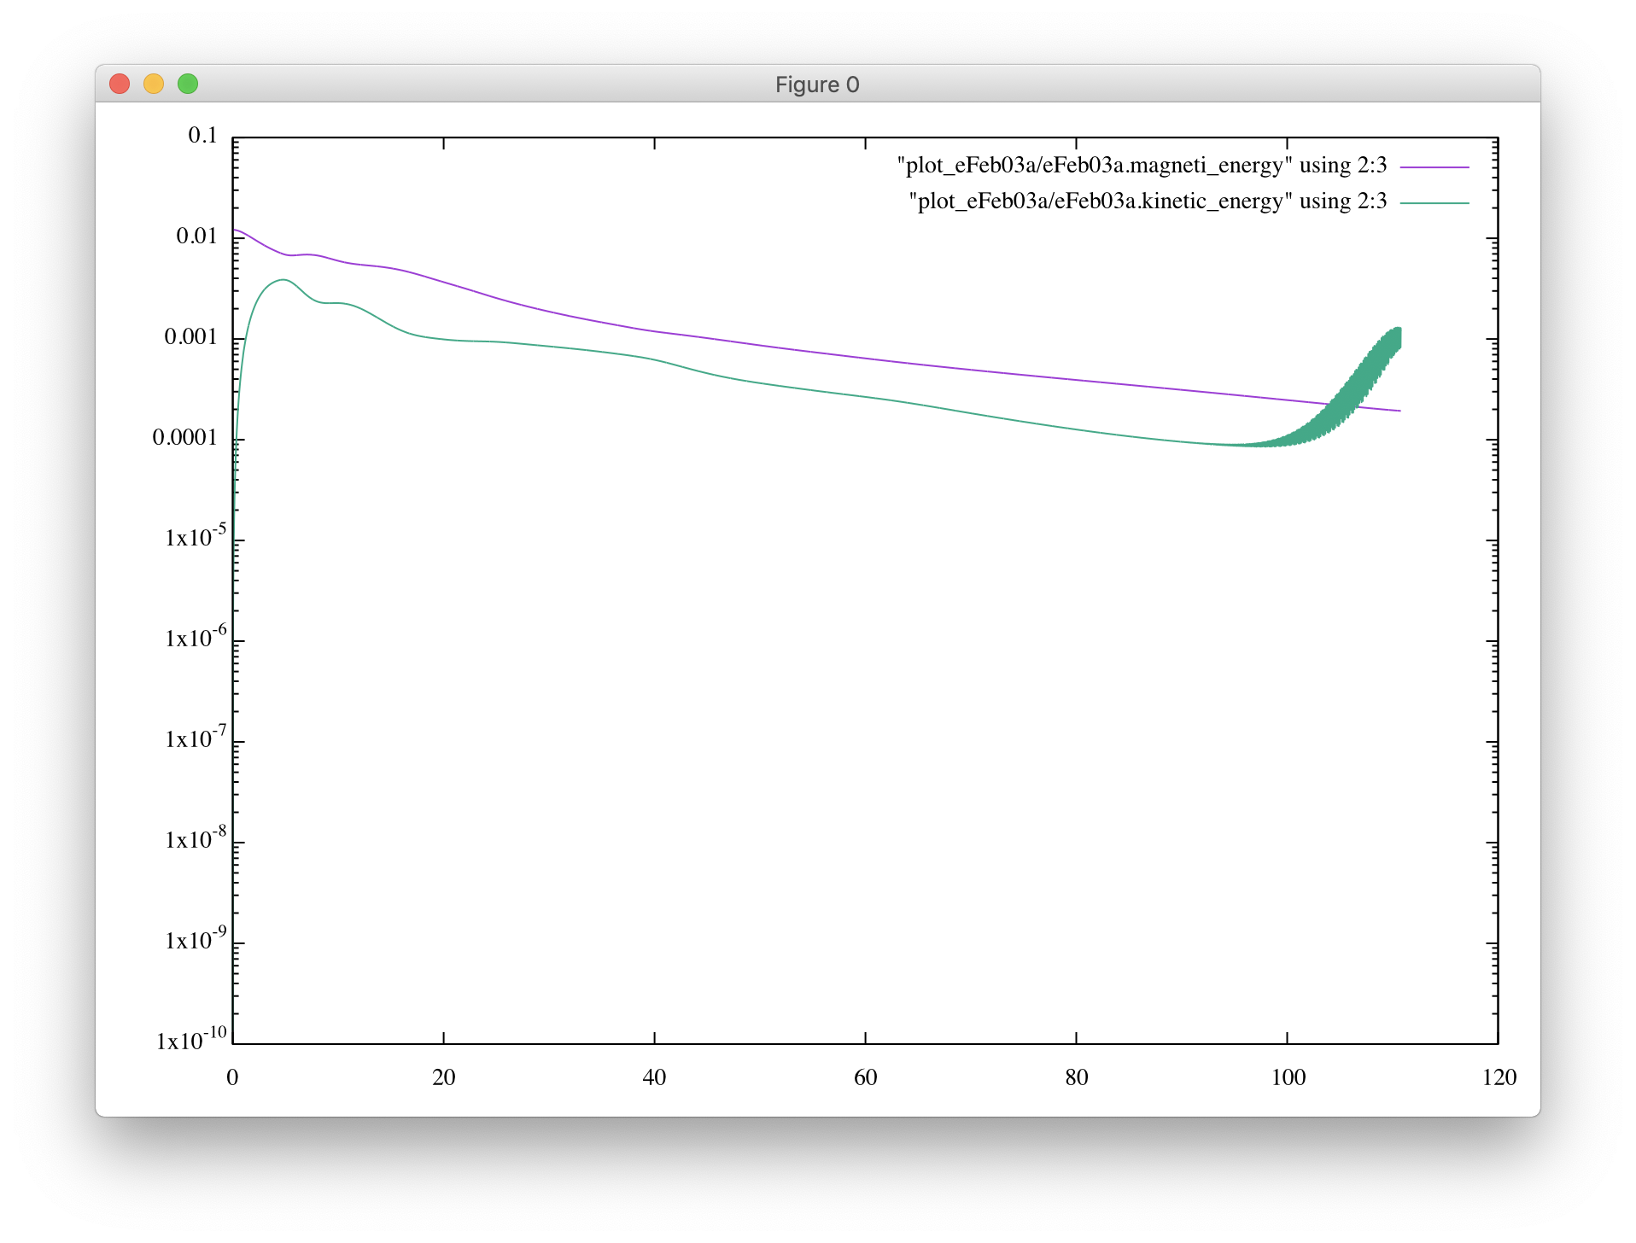
境界条件の変更
Notes:
Rigid境界の方が自然界で一般的
問題になるのは流れのエネルギーが消えてしまうこと

Slide 5
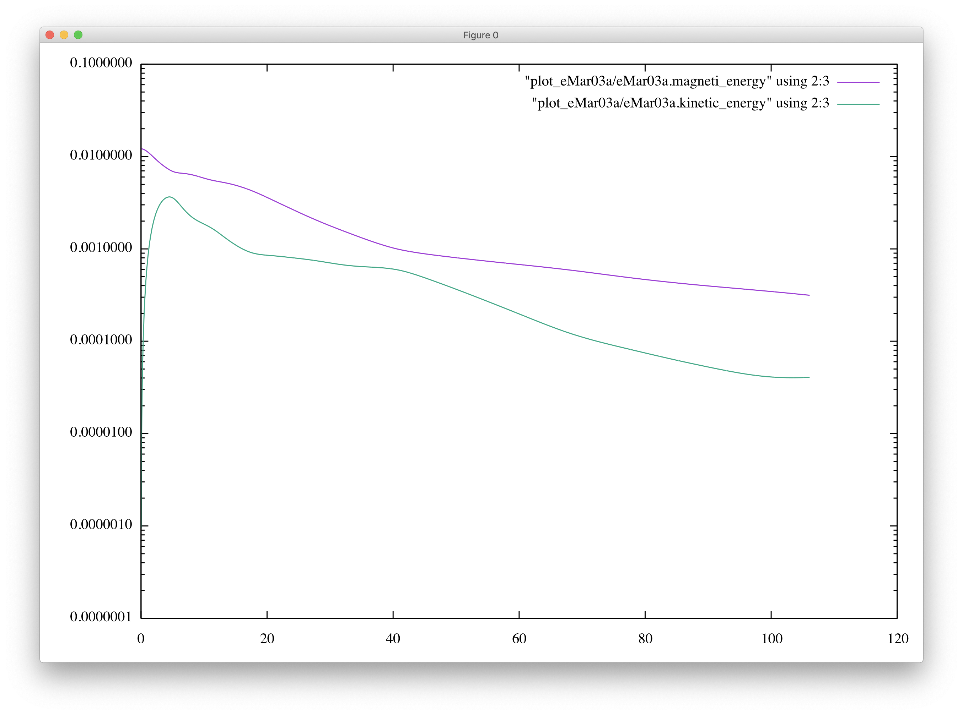
境界条件の変更
Notes:
Rigid境界の方が自然界で一般的
問題になるのは流れのエネルギーが消えてしまうこと

Slide 6
新たな初期条件の導入
リング磁場
非常に強い流れが起きる
⇒ シミュレーションの発散の原因
Notes:
Rigid境界の方が自然界で一般的
問題になるのは流れのエネルギーが消えてしまうこと

Slide 7
新たな初期条件の導入
解決策
リングの力を弱める ⇒弱めすぎると構造に変化が見られない
リングの数を増やす ⇒球面調和関数の導入
Notes:
リングの数を増やすとお互いのリングが縮まるのを妨げるため、発散を防ぐことができる

Slide 8
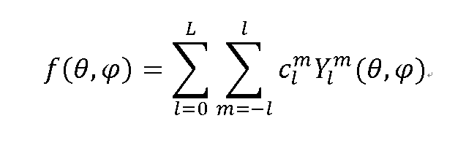
新たな初期条件の導入
球面調和関数とは？
球面上の関数 f(θ,φ) を展開するのに用いられる関数群のこと。 f(θ,φ) は球面調和関数の線形和で表される。
定数
球面調和関数
Notes:
リングの数を増やすとお互いのリングが縮まるのを妨げるため、発散を防ぐことができる

Slide 9
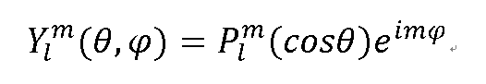
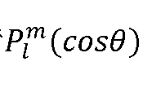
新たな初期条件の導入
球面調和関数の式
ルジャンドル陪関数 ：θ方向の展開を表す
(l,m)はそれぞれ緯度方向と経度方向のモードを表している ⇒ 磁気リングの数を調節できる
Notes:
リングの数を増やすとお互いのリングが縮まるのを妨げるため、発散を防ぐことができる

Slide 10
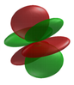
新たな初期条件の導入
モード：負の領域と正の領域のペアの数
例：(l,m)=(3,1)のとき、Y(3,1)~=A*cos(3θ)*cos(φ)
緯度方向
経度方向
＋
ー
ー
＋
＋
＝
＋
＋
ー
ー
https://ja.wikipedia.org/wiki/%E7%90%83%E9%9D%A2%E8%AA%BF%E5%92%8C%E9%96%A2%E6%95%B0
Notes:
赤は性の領域、緑は負の領域を示す
リングの数を増やすとお互いのリングが縮まるのを妨げるため、発散を防ぐことができる

Slide 11
新たな初期条件の導入
初期磁気ポテンシャル
Ar = AMP * r * (sin(πr)) * Plm(cosθ) * cos(mφ)
(l,m)=(3,1),(3,2),(3,3) の３パターンでシミュレーション
Notes:
リングの数を増やすとお互いのリングが縮まるのを妨げるため、発散を防ぐことができる

Slide 12
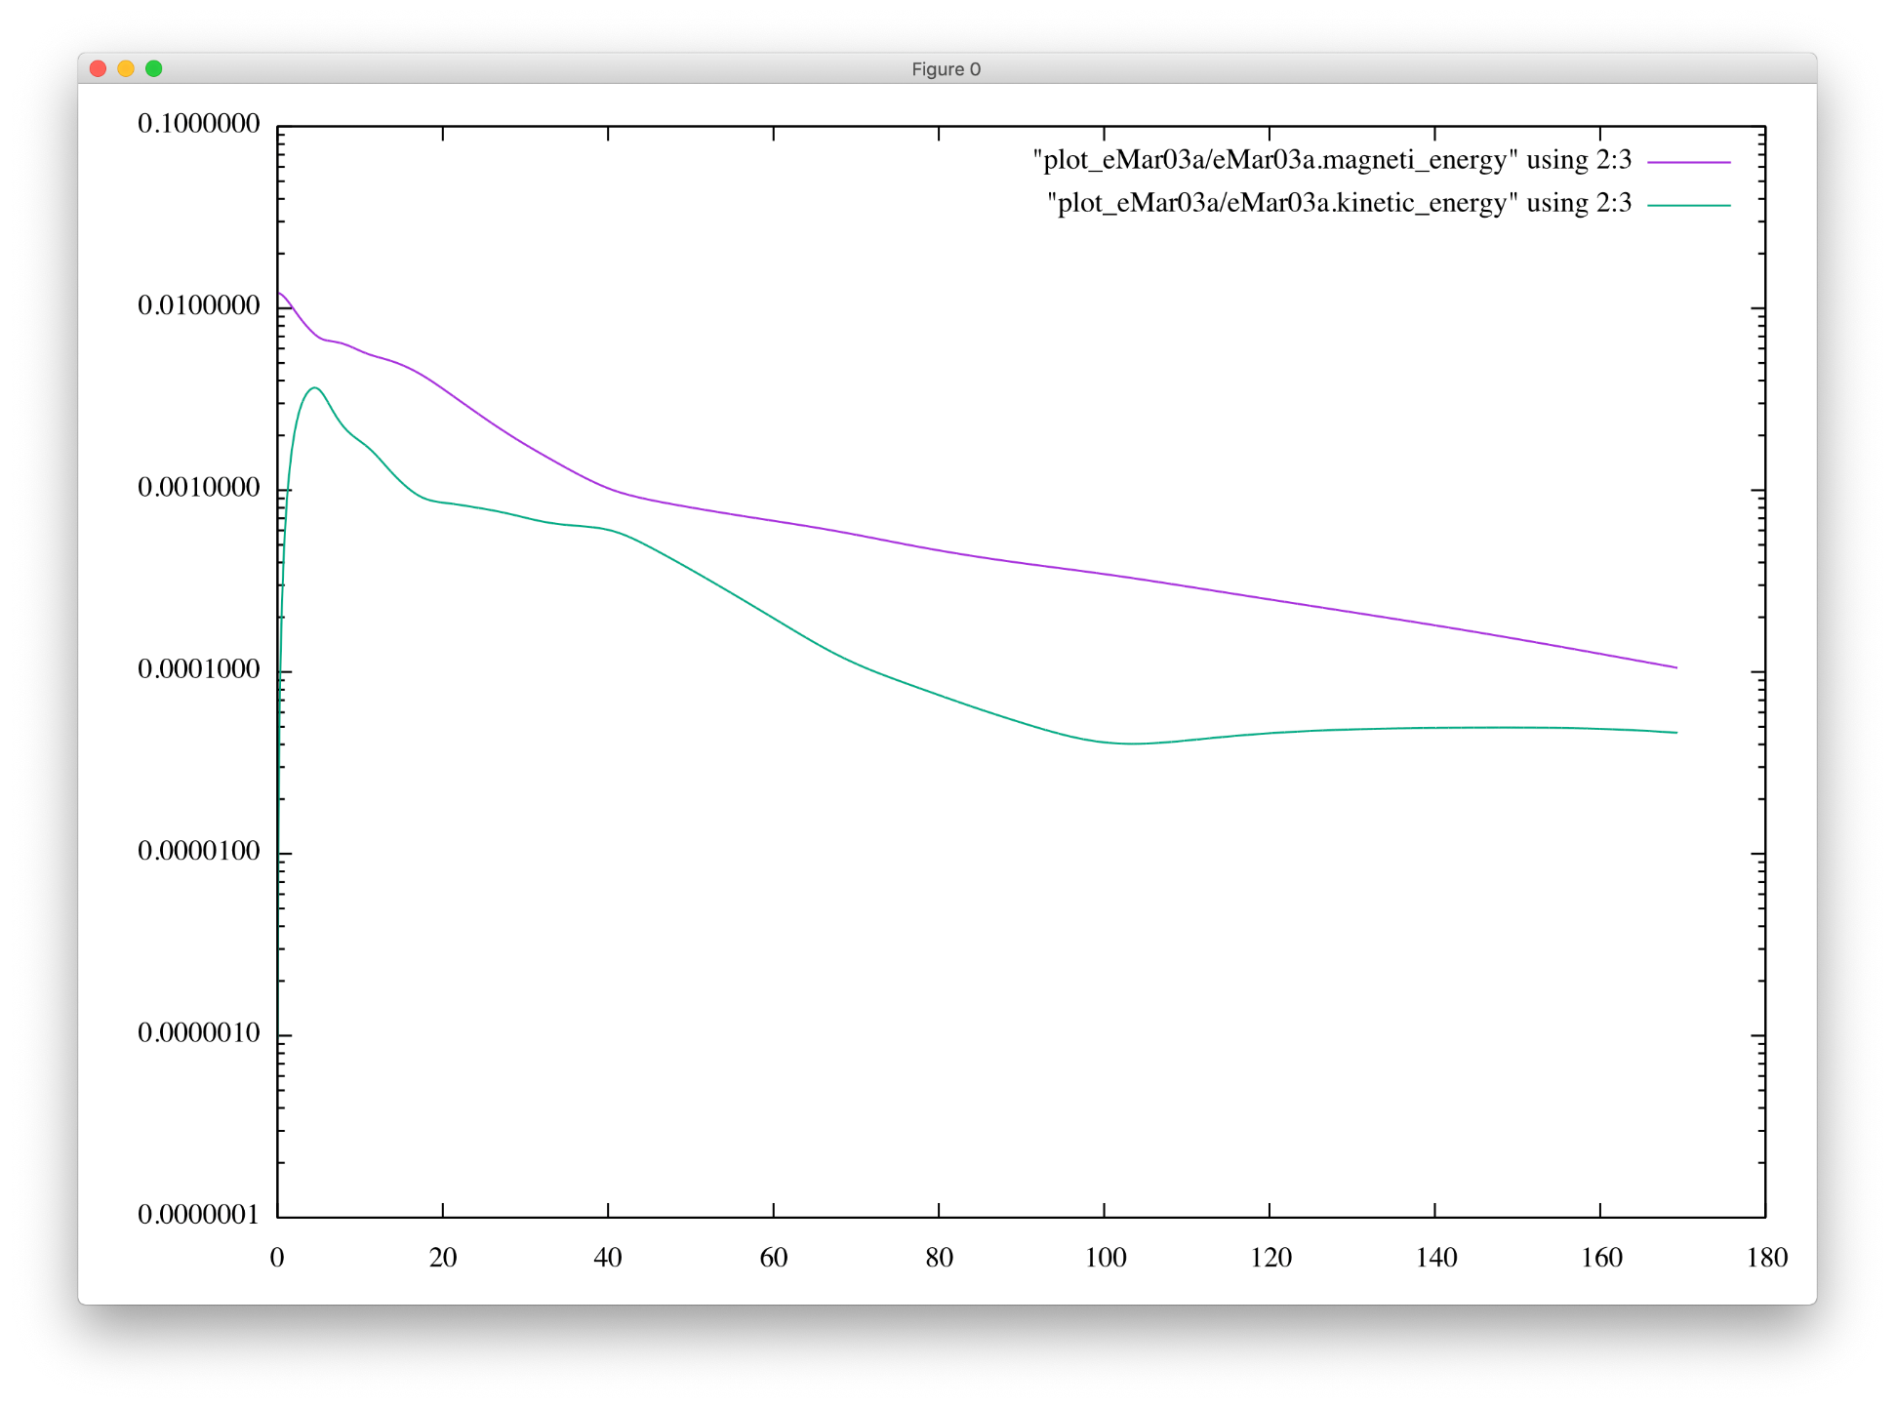
構造の発見（l=3,m=1）
Notes:
リングの数を増やすとお互いのリングが縮まるのを妨げるため、発散を防ぐことができる

Slide 13
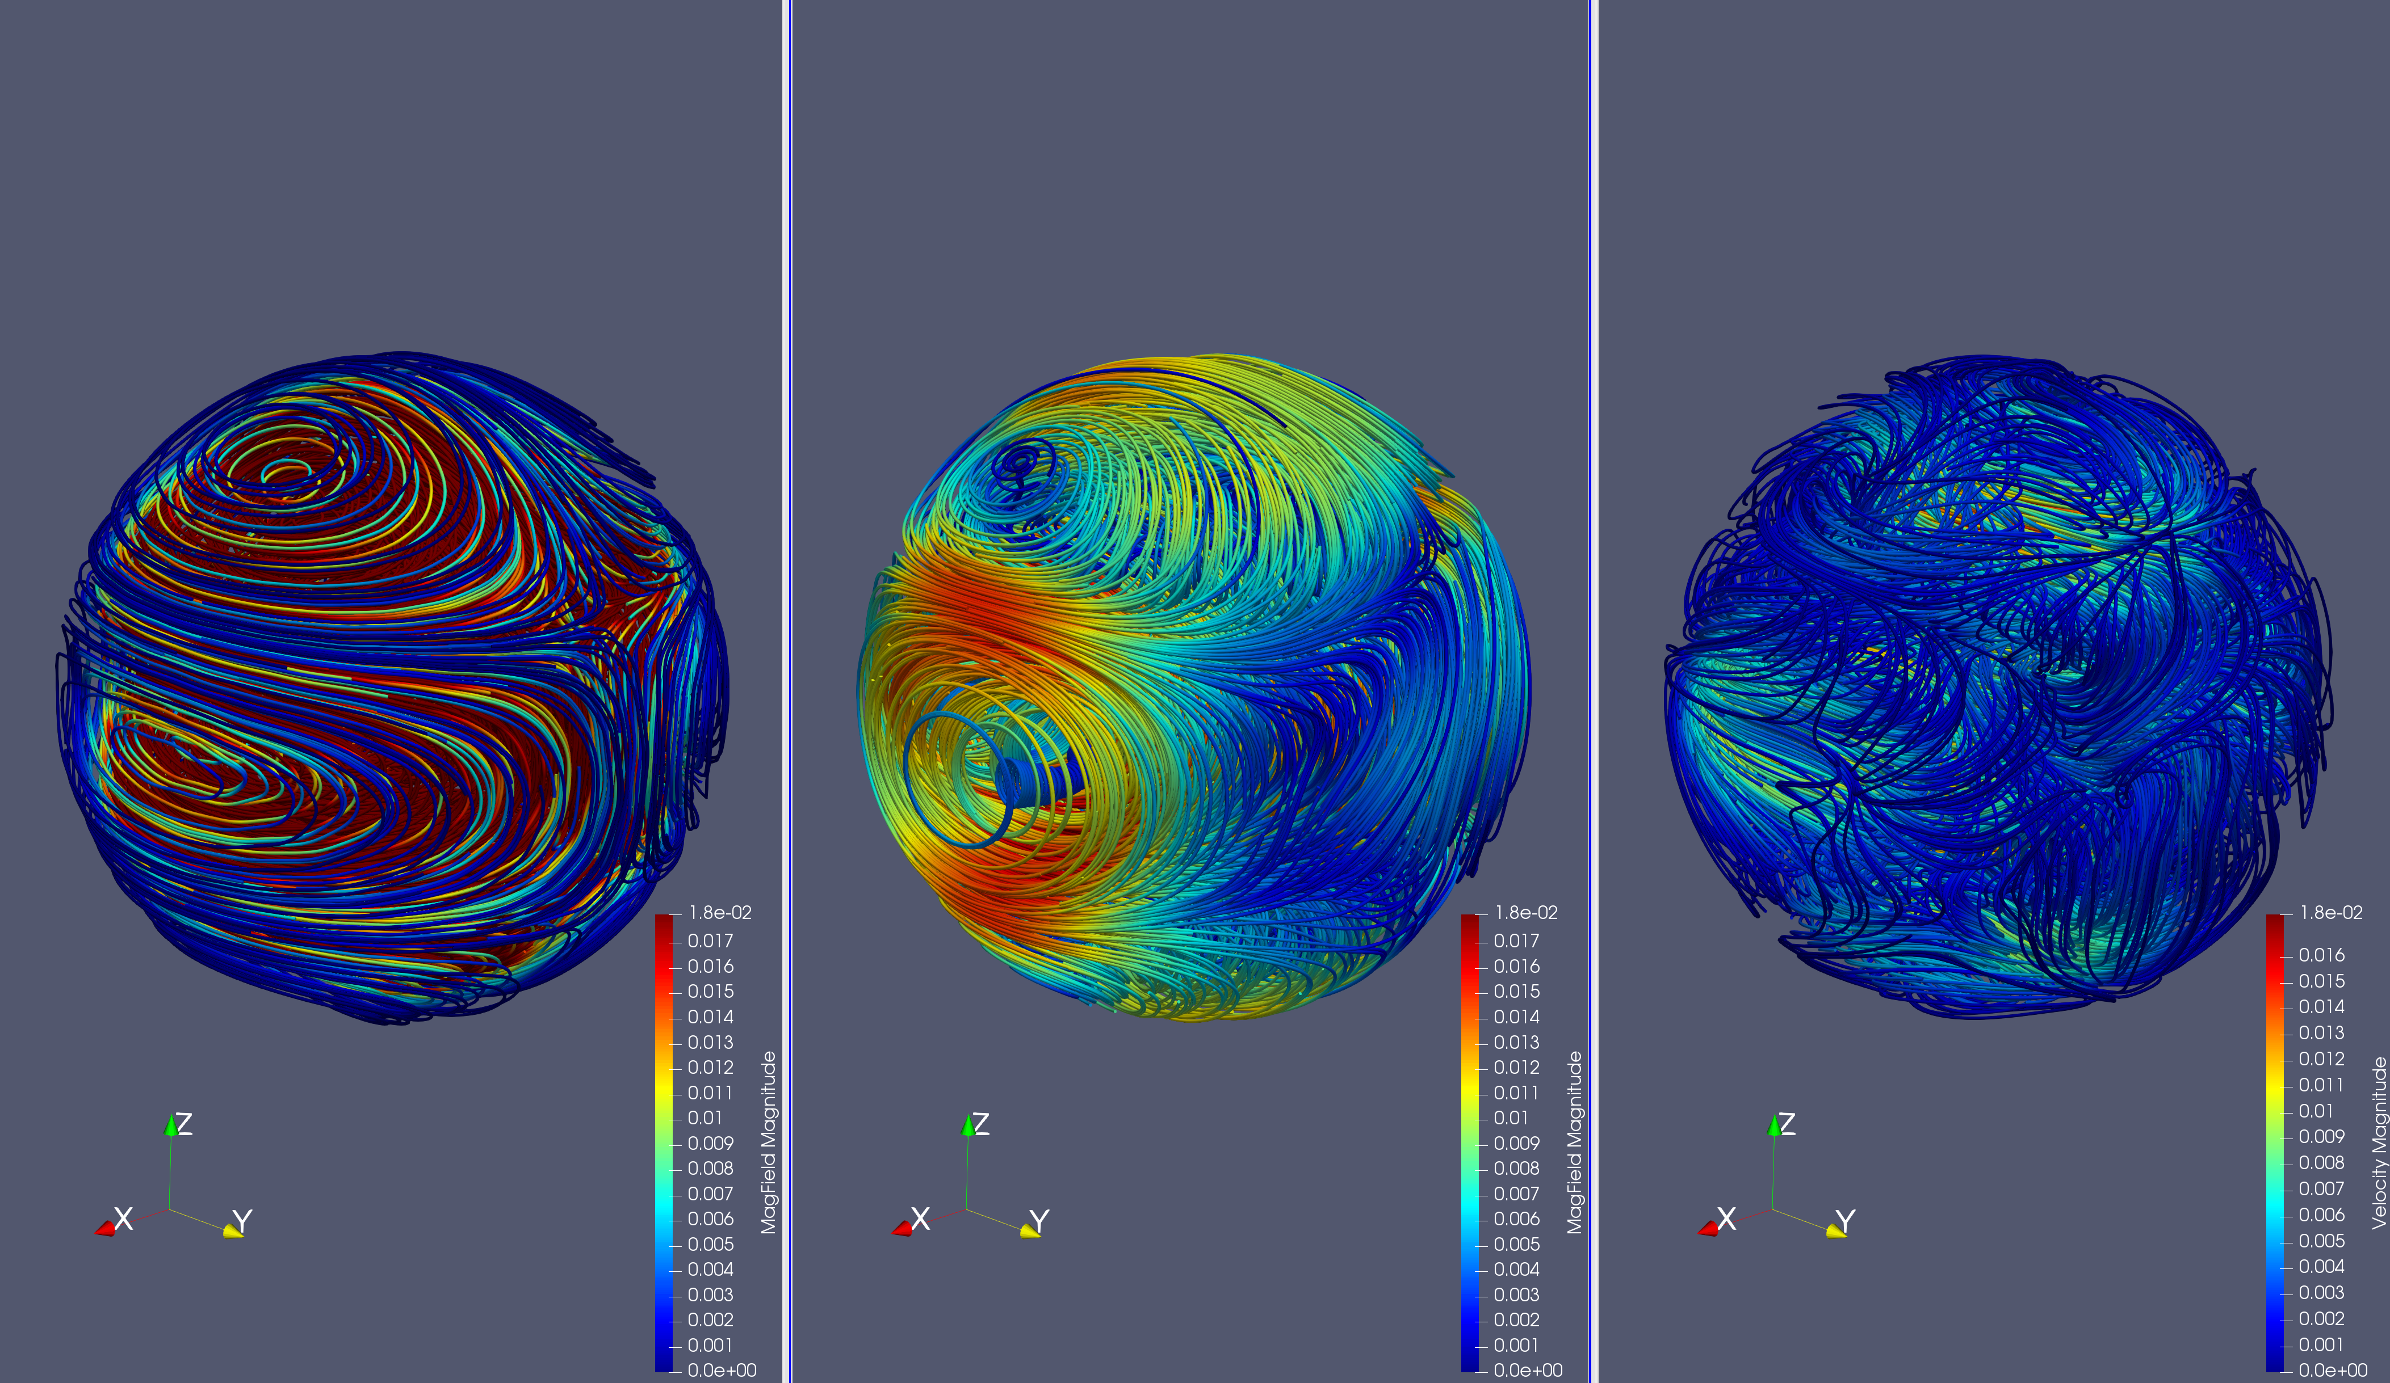
構造の発見（l=3,m=1）
「初期磁場」「緩和磁場(t=144)」「緩和流れ場(t=144) 」
Notes:
リングの数を増やすとお互いのリングが縮まるのを妨げるため、発散を防ぐことができる

Slide 14
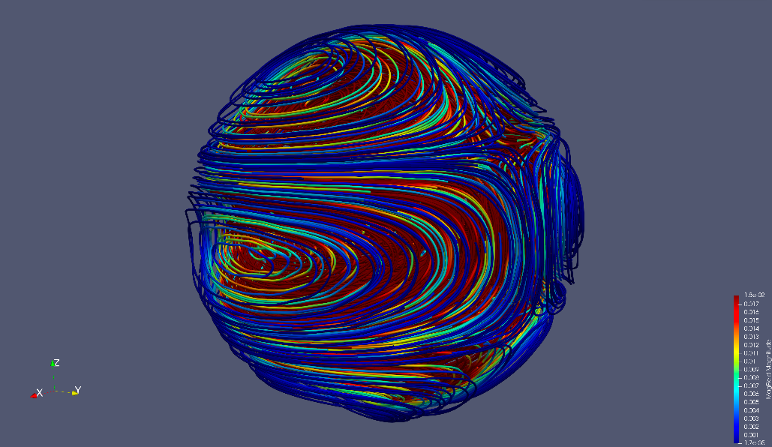
構造の発見（l=3,m=1）
初期磁場
Z
X
Y
Notes:
As you know, Fortran is very popular in High Performance Computing or HPC.
And, this language is very powerful for computer simulations.
And as you know, Fortran has been revised for many times including some major revises such as this one.
We call the last two revisions “the Modern Fortran”.
These revisions introduce some new and very useful features to the language such as …

Slide 15
構造の発見（l=3,m=1）
緩和状態
磁場と流れ場
Z
X
Y
Notes:
As you know, Fortran is very popular in High Performance Computing or HPC.
And, this language is very powerful for computer simulations.
And as you know, Fortran has been revised for many times including some major revises such as this one.
We call the last two revisions “the Modern Fortran”.
These revisions introduce some new and very useful features to the language such as …

Slide 16
構造の発見（l=3,m=1）
赤道断面
磁力線の輪が縮まり、流れの駆動力になる
X
Y
流れによって磁力線が引き伸ばされる
Notes:
As you know, Fortran is very popular in High Performance Computing or HPC.
And, this language is very powerful for computer simulations.
And as you know, Fortran has been revised for many times including some major revises such as this one.
We call the last two revisions “the Modern Fortran”.
These revisions introduce some new and very useful features to the language such as …

Slide 17
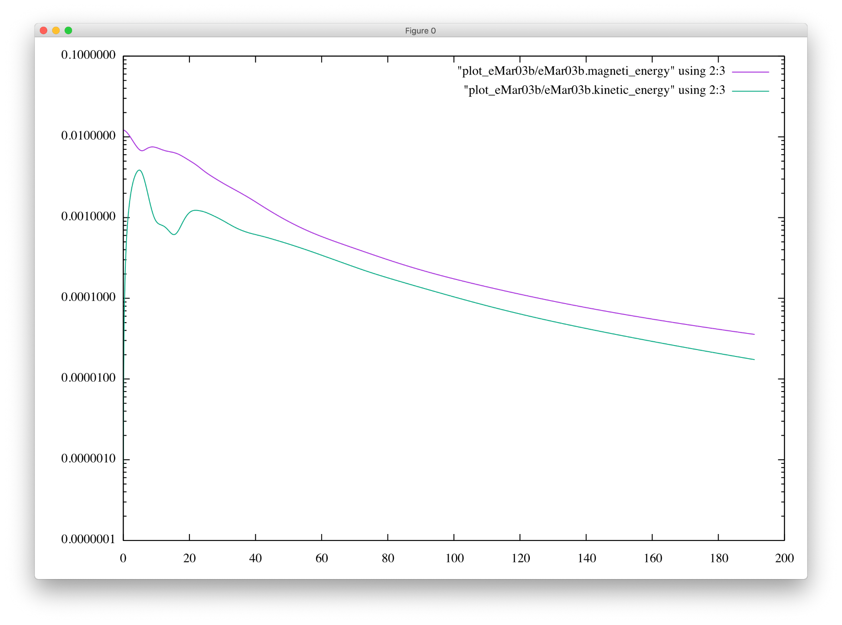
構造の発見（l=3,m=2）
Notes:
リングの数を増やすとお互いのリングが縮まるのを妨げるため、発散を防ぐことができる

Slide 18
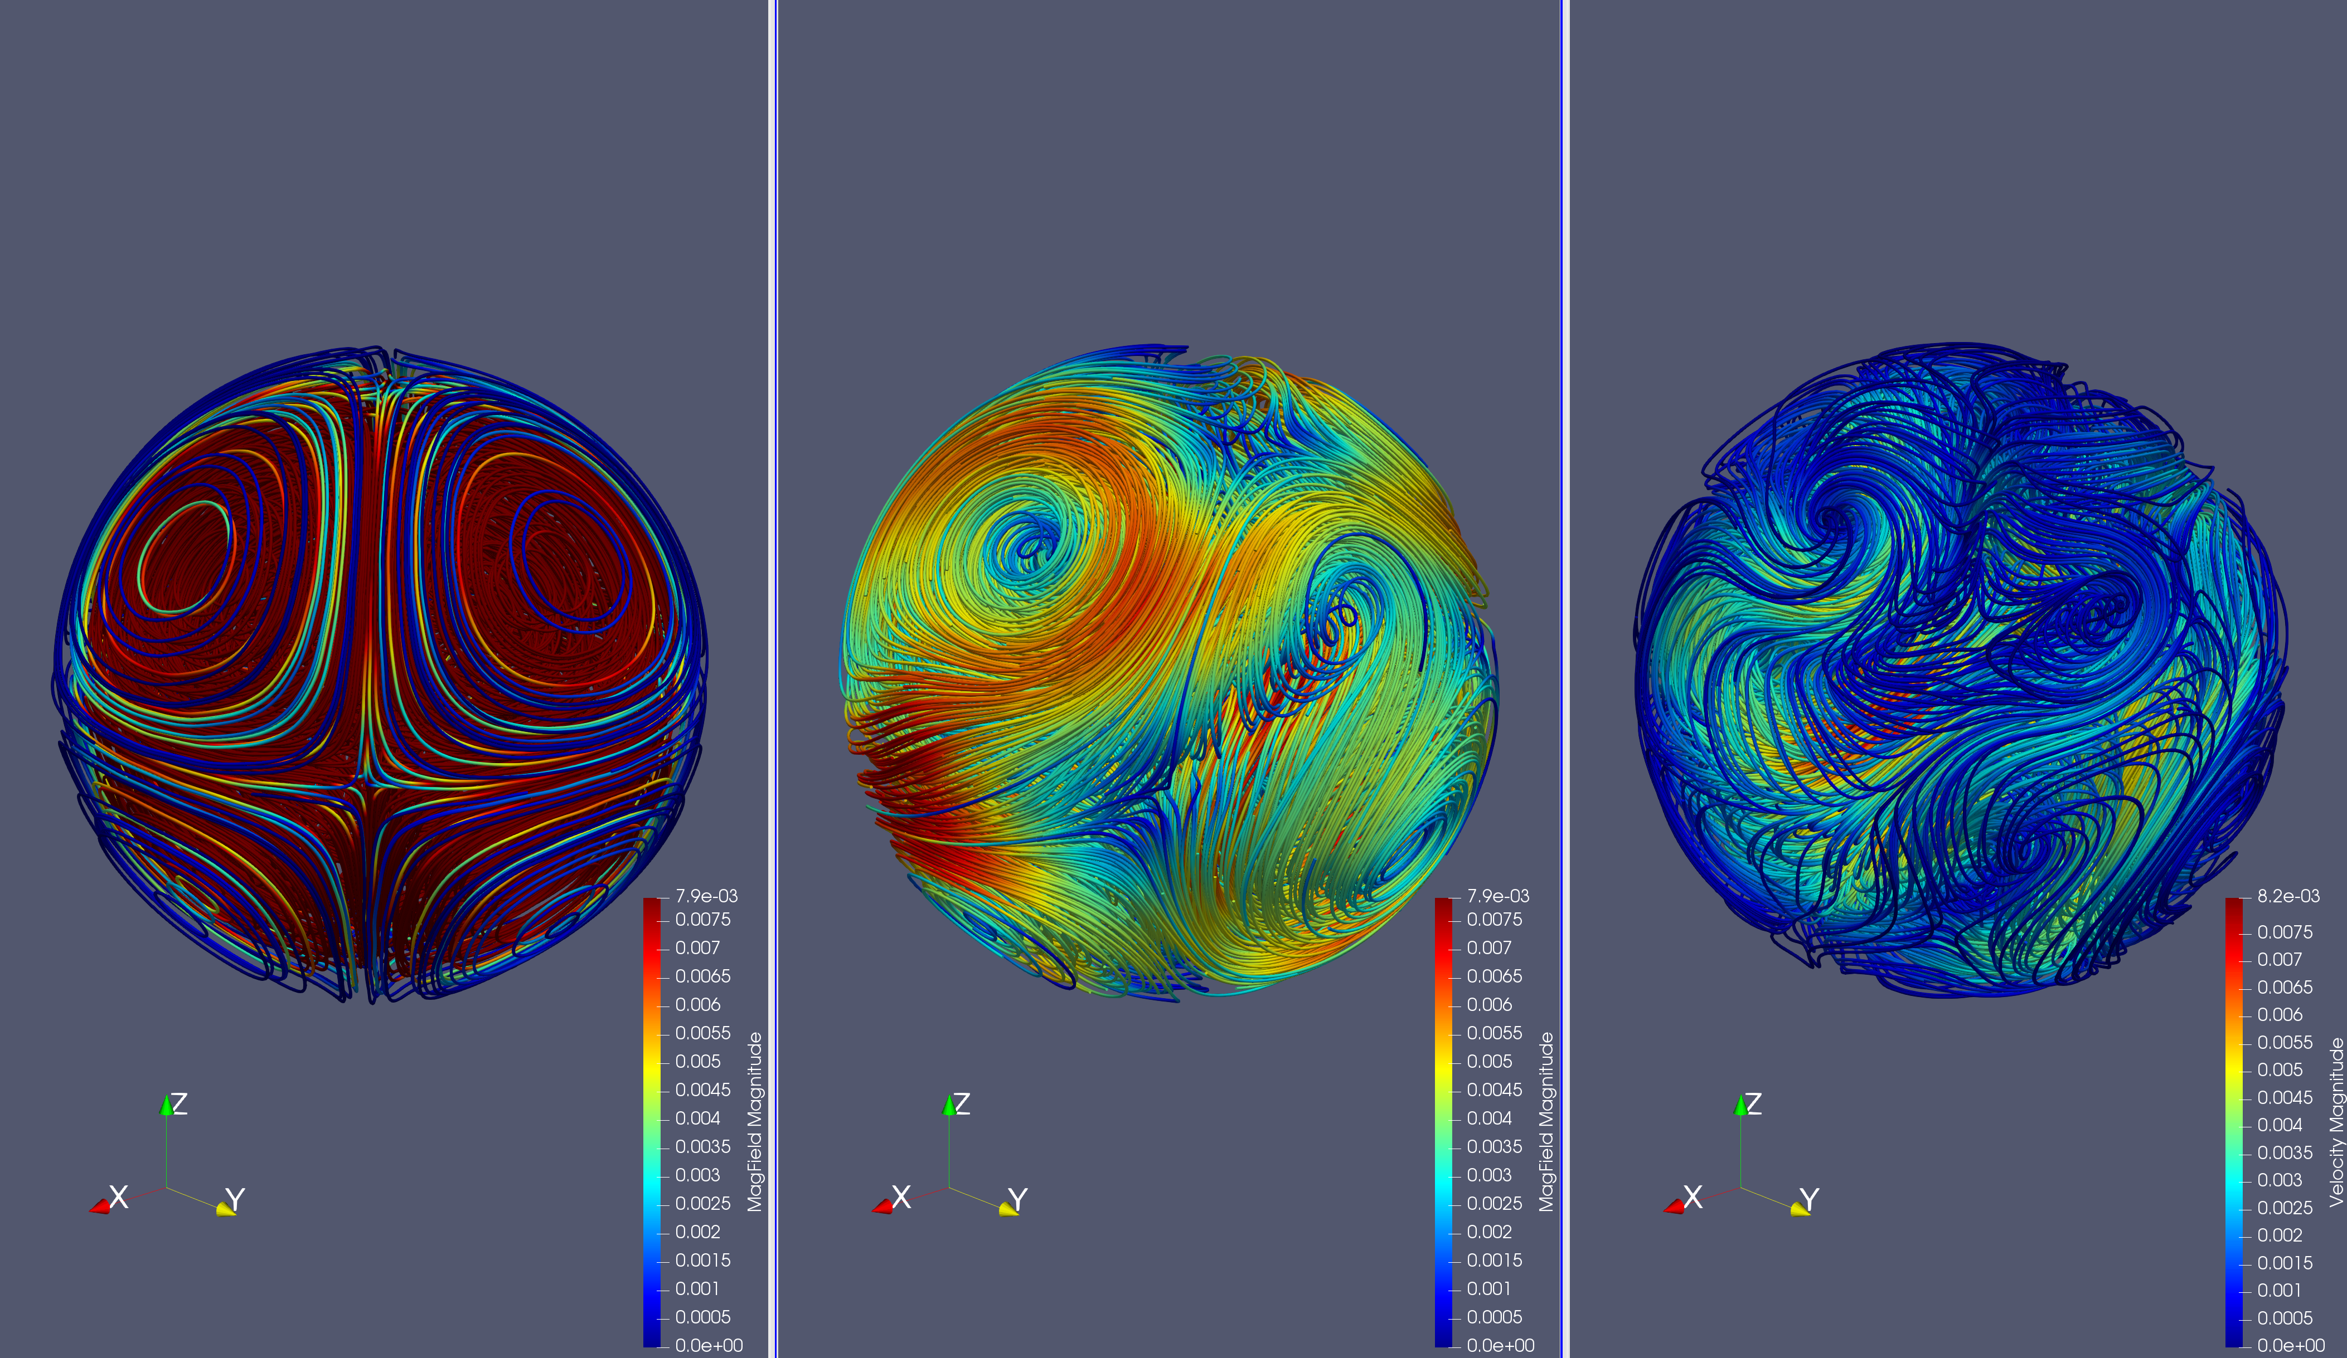
構造の発見（l=3,m=2）
「初期磁場」「緩和磁場(t=190)」「緩和流れ場(t=190) 」
Notes:
リングの数を増やすとお互いのリングが縮まるのを妨げるため、発散を防ぐことができる

Slide 19
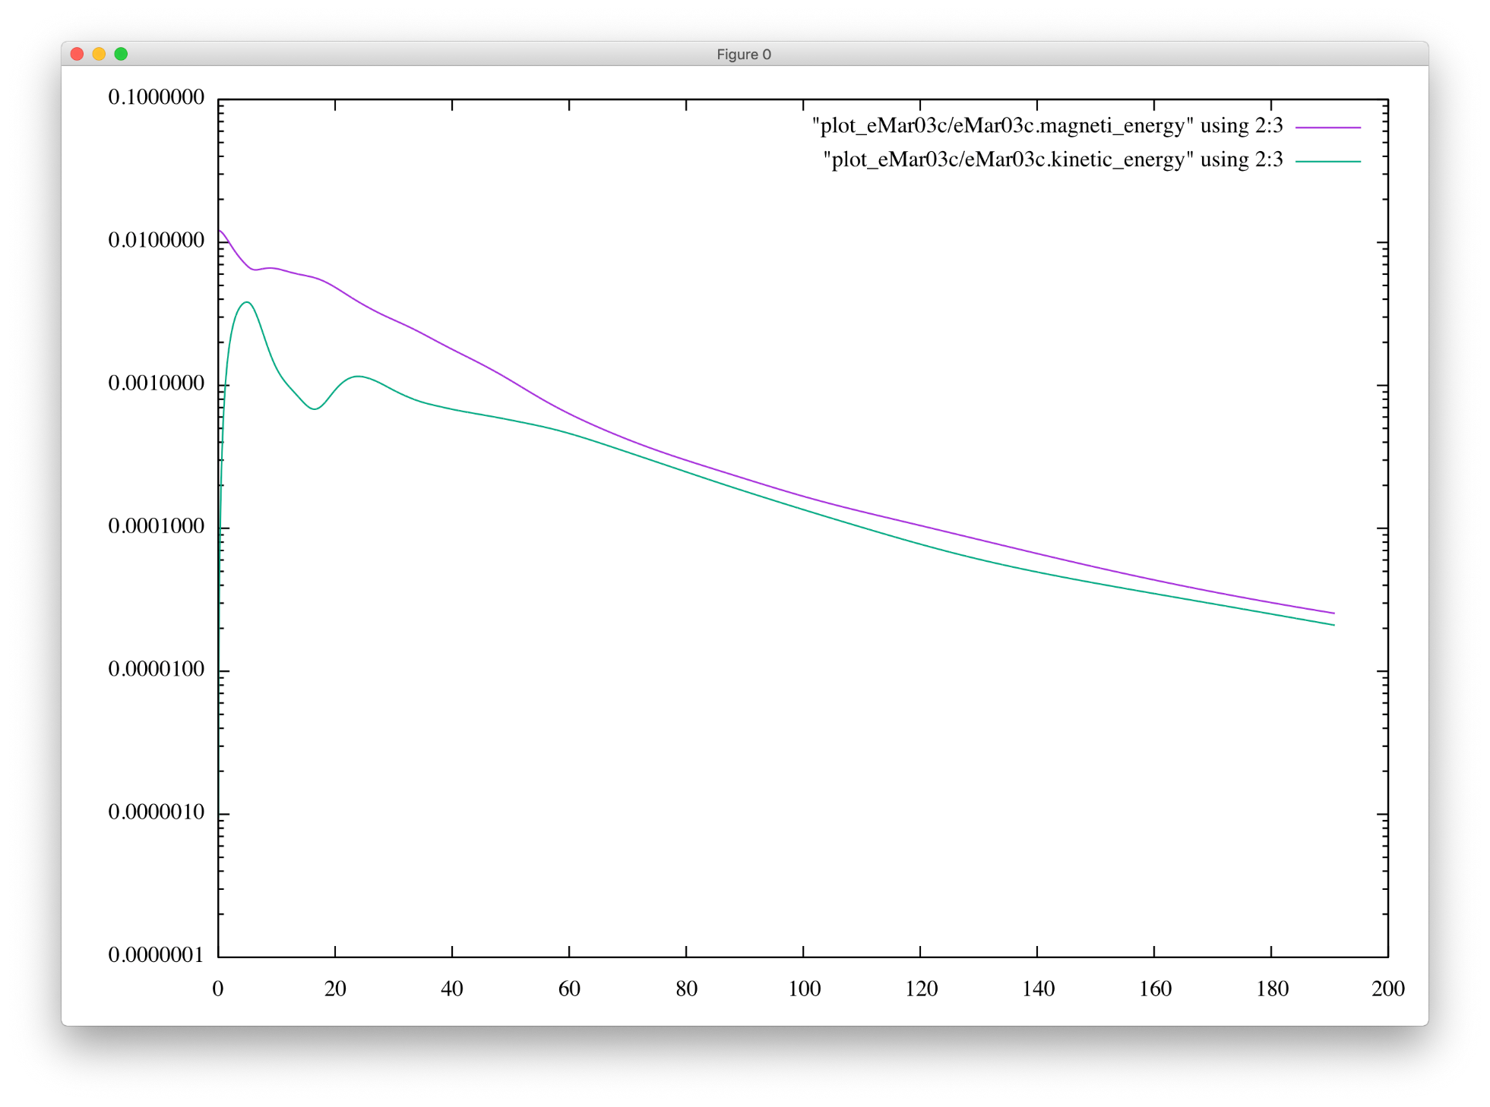
構造の発見（l=3,m=3）
Notes:
リングの数を増やすとお互いのリングが縮まるのを妨げるため、発散を防ぐことができる

Slide 20
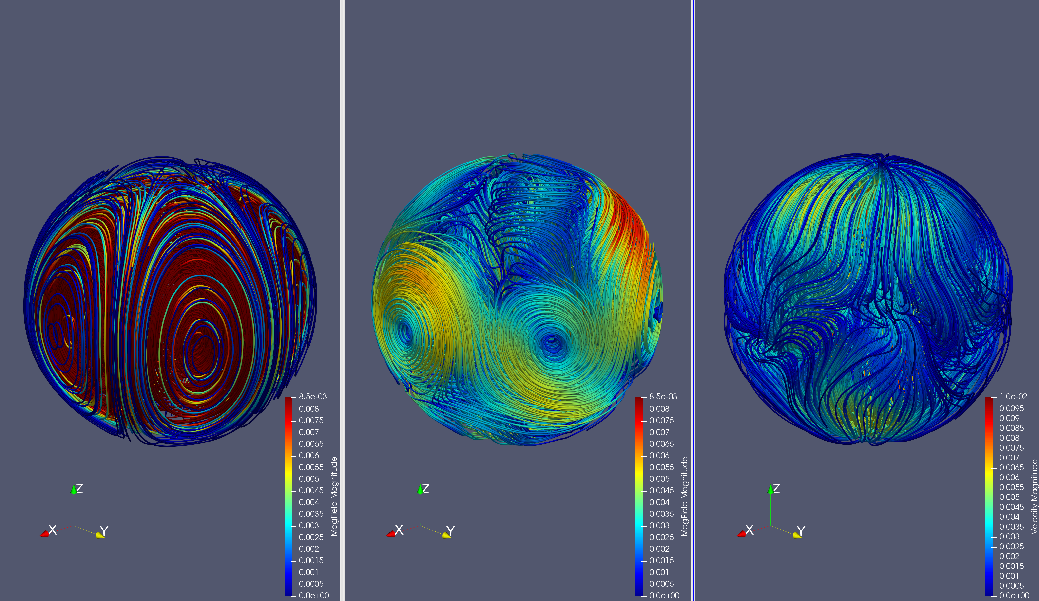
構造の発見（l=3,m=3）
「初期磁場」「緩和磁場(t=190)」「緩和流れ場(t=190) 」
Notes:
リングの数を増やすとお互いのリングが縮まるのを妨げるため、発散を防ぐことができる

Slide 21
構造の発見（l=3,m=3）
初期磁場
Z
X
Y
Notes:
As you know, Fortran is very popular in High Performance Computing or HPC.
And, this language is very powerful for computer simulations.
And as you know, Fortran has been revised for many times including some major revises such as this one.
We call the last two revisions “the Modern Fortran”.
These revisions introduce some new and very useful features to the language such as …

Slide 22
構造の発見（l=3,m=3）
緩和状態
磁場と流れ場
Z
X
Y
Notes:
As you know, Fortran is very popular in High Performance Computing or HPC.
And, this language is very powerful for computer simulations.
And as you know, Fortran has been revised for many times including some major revises such as this one.
We call the last two revisions “the Modern Fortran”.
These revisions introduce some new and very useful features to the language such as …

Slide 23
今後の課題
(l,m)=(3,2)の構造解析
その他(l,m)を変えてシミュレーション ⇒(l,m)に対応した緩和状態の表
解像度を高める
Notes:
リングの数を増やすとお互いのリングが縮まるのを妨げるため、発散を防ぐことができる

Slide 25
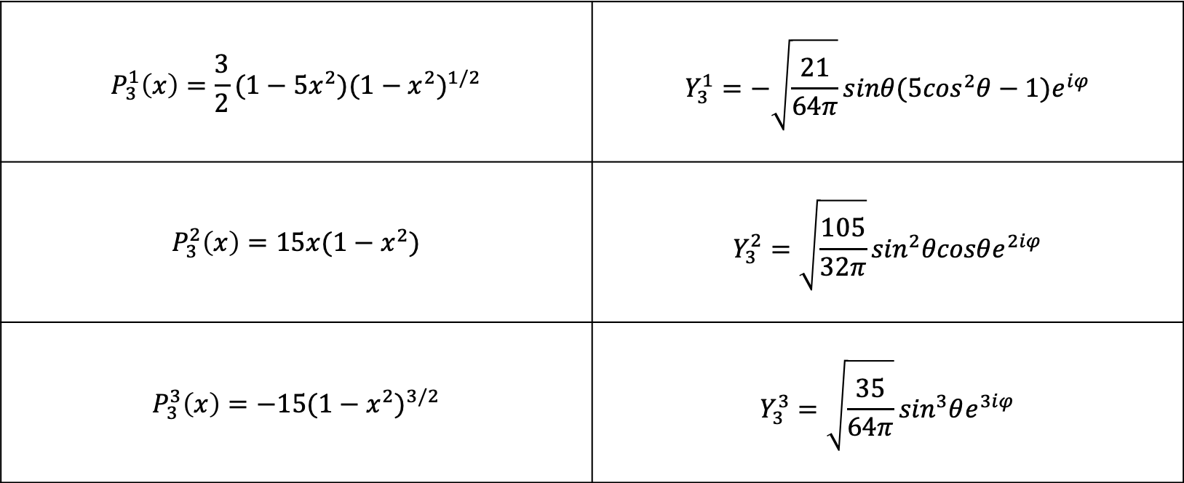
ルジャンドル陪関数と球面調和関数
$$P_{3}^{1}\left(x\right)=\frac{3}{2}(1−5x^{2}){(1−x^{2})}^{1/2}$$ | $$Y_{3}^{1}=−\sqrt{\frac{21}{64π}}sinθ(5\cos^{2}θ−1)e^{iφ}$$
$$P_{3}^{2}\left(x\right)=15x(1−x^{2})$$ | $$Y_{3}^{2}=\sqrt{\frac{105}{32π}}\sin^{2}θcosθe^{2iφ}$$
$$P_{3}^{3}\left(x\right)={−15(1−x^{2})}^{3/2}$$ | $$Y_{3}^{3}=\sqrt{\frac{35}{64π}}\sin^{3}θe^{3iφ}$$
Notes:
リングの数を増やすとお互いのリングが縮まるのを妨げるため、発散を防ぐことができる

Slide 26
構造の発見（l=3,m=3）
緩和磁場
Z
X
Y
Notes:
As you know, Fortran is very popular in High Performance Computing or HPC.
And, this language is very powerful for computer simulations.
And as you know, Fortran has been revised for many times including some major revises such as this one.
We call the last two revisions “the Modern Fortran”.
These revisions introduce some new and very useful features to the language such as …

Slide 27
構造の発見（l=3,m=1）
緩和状態
磁場と流れ場
Z
X
Y
Notes:
As you know, Fortran is very popular in High Performance Computing or HPC.
And, this language is very powerful for computer simulations.
And as you know, Fortran has been revised for many times including some major revises such as this one.
We call the last two revisions “the Modern Fortran”.
These revisions introduce some new and very useful features to the language such as …

Slide 28
構造の発見（l=3,m=1）
初期磁場
Z
X
Y
Notes:
As you know, Fortran is very popular in High Performance Computing or HPC.
And, this language is very powerful for computer simulations.
And as you know, Fortran has been revised for many times including some major revises such as this one.
We call the last two revisions “the Modern Fortran”.
These revisions introduce some new and very useful features to the language such as …

Slide 29
構造の発見（l=3,m=1）
緩和状態
磁場と流れ場
Z
X
Y
Notes:
As you know, Fortran is very popular in High Performance Computing or HPC.
And, this language is very powerful for computer simulations.
And as you know, Fortran has been revised for many times including some major revises such as this one.
We call the last two revisions “the Modern Fortran”.
These revisions introduce some new and very useful features to the language such as …

Slide 30
L=3,M=1 流れ場と磁場の重ね合わせ （XY平面 極付近）
小さいリング
大きいリング
X
Y
Notes:
As you know, Fortran is very popular in High Performance Computing or HPC.
And, this language is very powerful for computer simulations.
And as you know, Fortran has been revised for many times including some major revises such as this one.
We call the last two revisions “the Modern Fortran”.
These revisions introduce some new and very useful features to the language such as …

Slide 31
L=3,M=1 磁場
Z
X
Y
Notes:
As you know, Fortran is very popular in High Performance Computing or HPC.
And, this language is very powerful for computer simulations.
And as you know, Fortran has been revised for many times including some major revises such as this one.
We call the last two revisions “the Modern Fortran”.
These revisions introduce some new and very useful features to the language such as …

Slide 32
L=3,M=1 流れ場
Z
X
Y
Notes:
As you know, Fortran is very popular in High Performance Computing or HPC.
And, this language is very powerful for computer simulations.
And as you know, Fortran has been revised for many times including some major revises such as this one.
We call the last two revisions “the Modern Fortran”.
These revisions introduce some new and very useful features to the language such as …

Slide 33
L=3,M=1 流れ場と磁場の重ね合わせ
Z
X
Y
Notes:
As you know, Fortran is very popular in High Performance Computing or HPC.
And, this language is very powerful for computer simulations.
And as you know, Fortran has been revised for many times including some major revises such as this one.
We call the last two revisions “the Modern Fortran”.
These revisions introduce some new and very useful features to the language such as …

